Slide 1

FACTORS AFFECTING STUDENT ACADEMIC PERFORMANCE
Anjiya Adil, Aryan Gandhi, Avery Funston, Utkarsh Singh

Slide 2
TABLE OF CONTENTS
01
02
03
04
05
Overview
Literature Review
Descriptive Data Analysis
Methodology
Results
06
Limitations and Future Research

Slide 3

01
Project Overview

Slide 4

Literary Overview
Sleep Quality and Well being
Hours Studied
Attendance
Access to Resources
Socio-economic Status

Slide 5

02
Descriptive Data Analysis

Slide 6
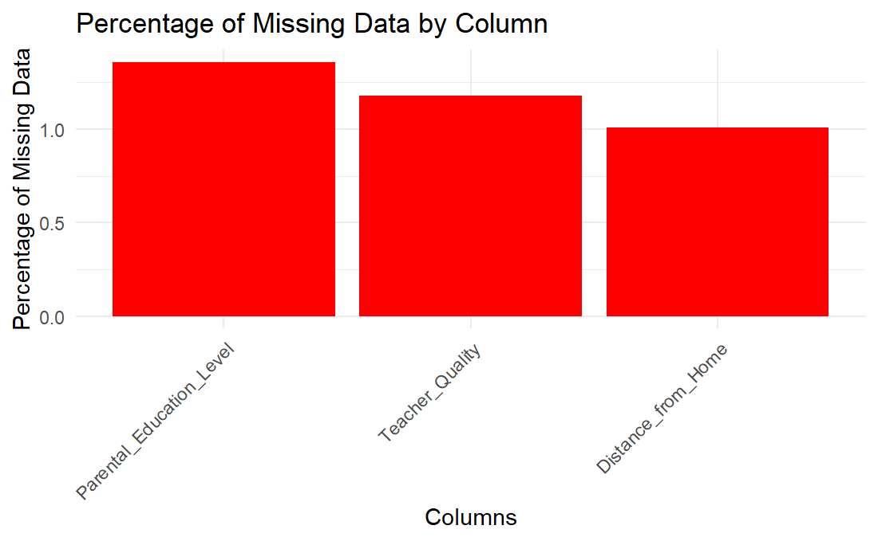
Data Pre-Processing
Check for Missing Values
235 rows with missing values
Percentage of missing data plotted
Missing rows set N/A and removed
Check for Outliers
Exam Score had an outlier i.e. 101
Percentage of missing data plotted in a box plot

Slide 7
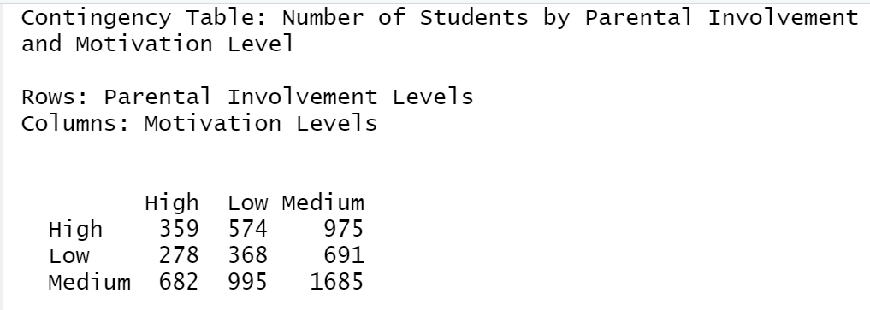
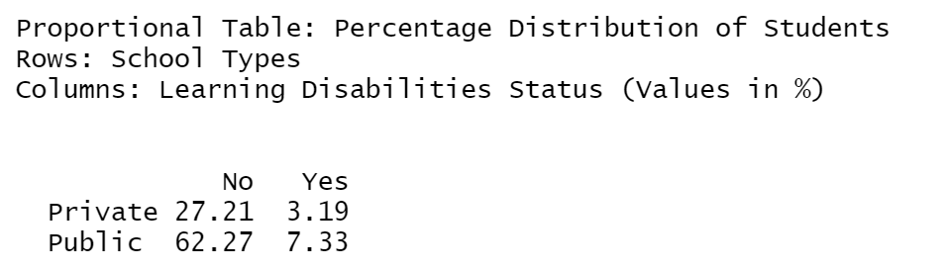
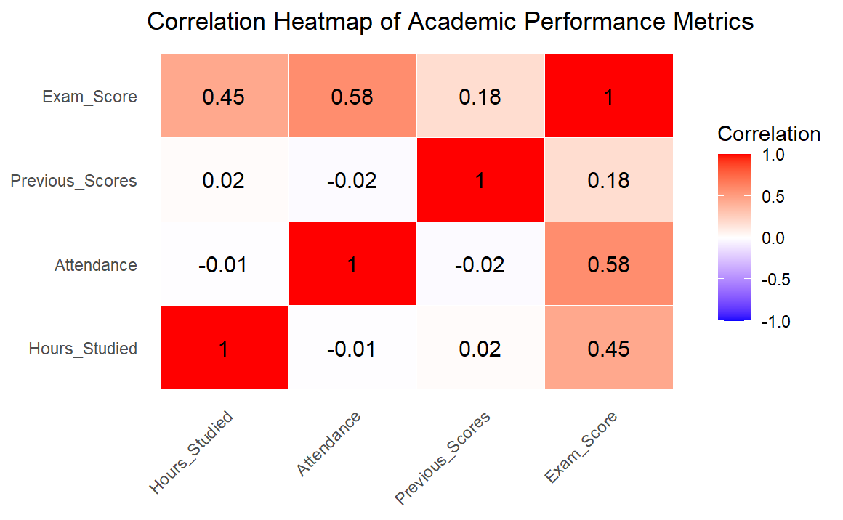
Descriptive Data Analysis
Exam scores show moderate skewness Gender, school type and access to resources display balanced distribution while extracurricular is skewed towards fewer participants as observed from data summary.
Motivation levels depict a strong association where high parental engagement correlates with higher motivation in students as seen in cross tabulation
Hours Studied and Exam Scores: 0.45 shows a moderate positive correlation
Attendance and Exam Scores: 0.58 shows strong positive correlation
Previous Scores and Exam Scores: 0.18 shows weak positive correlation

Slide 8
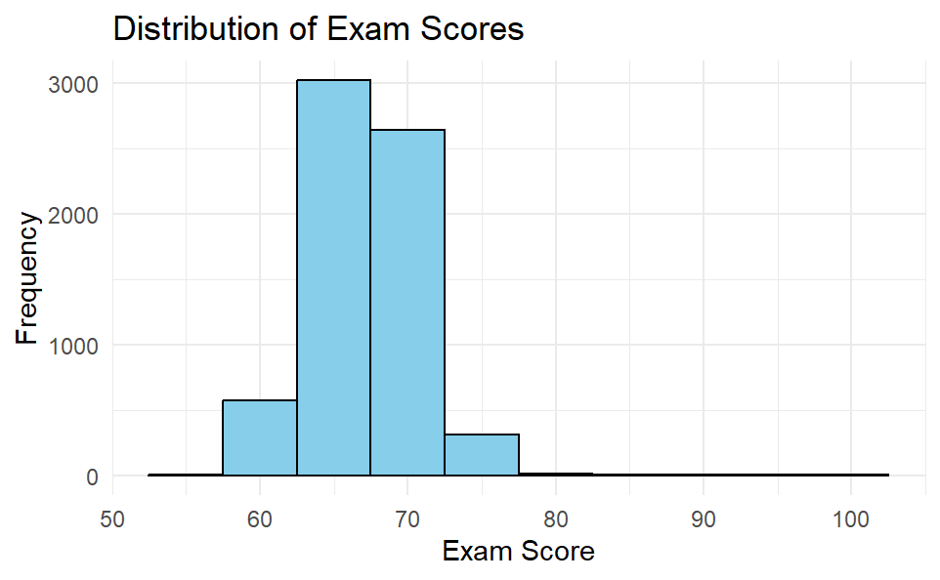
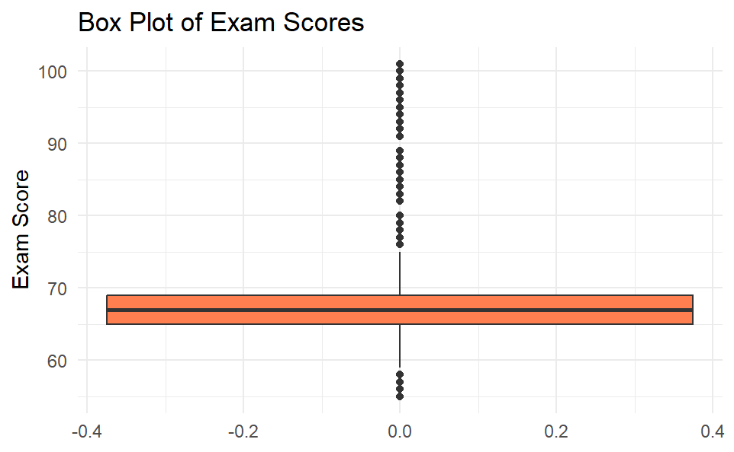
Descriptive Data Analysis
Slightly skewed distribution of exam scores with many students scoring from mid to mid-high range, showing moderate to mid high academic performance while also showing a percentage of low performers
Box plot highlights that most students in the range 65-68 range while some exceptional performers are seen above the typical range while few are below

Slide 9
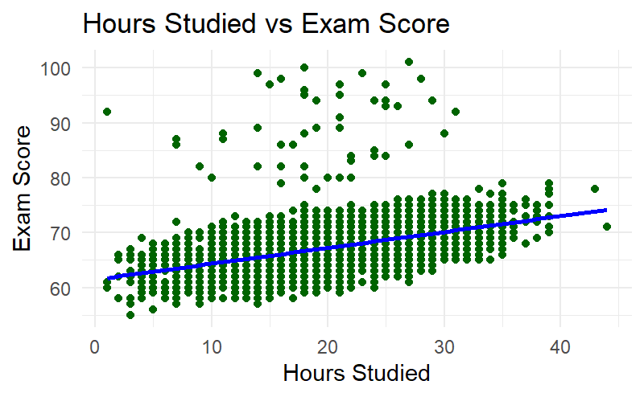
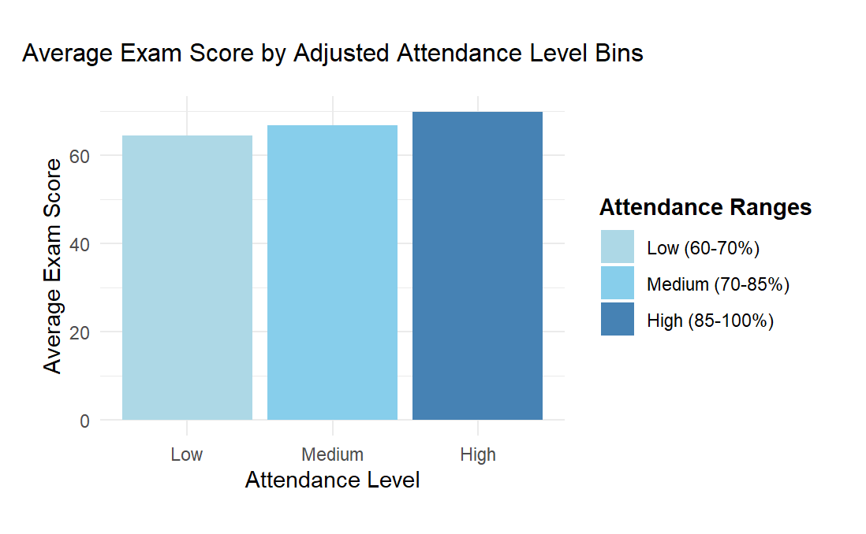
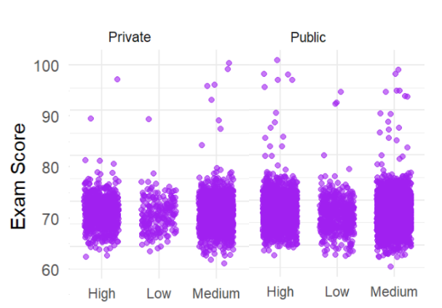
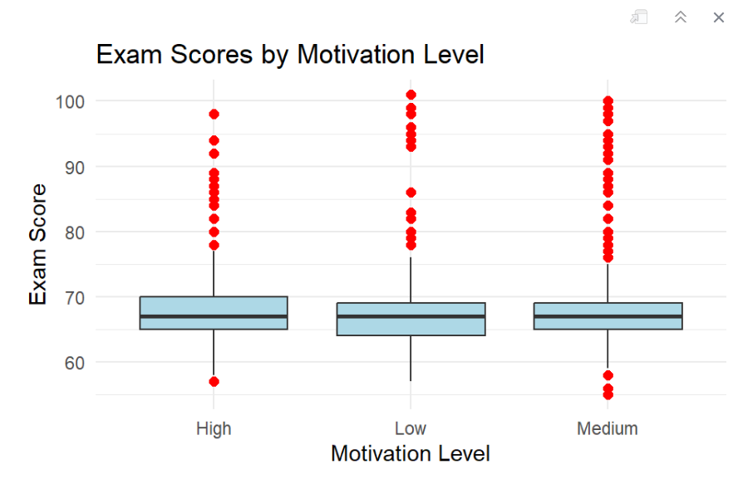
Descriptive Data Analysis
Positive relationship between attendance level of students and their average exam score
Positive linear relationship between hours studied and exam scores
Teacher quality is observed to have similar positive impact on both public and private schools
High motivation plot shows positive skewness, low motivation plot shows high positive skewness

Slide 10

03
Methodology

Slide 11
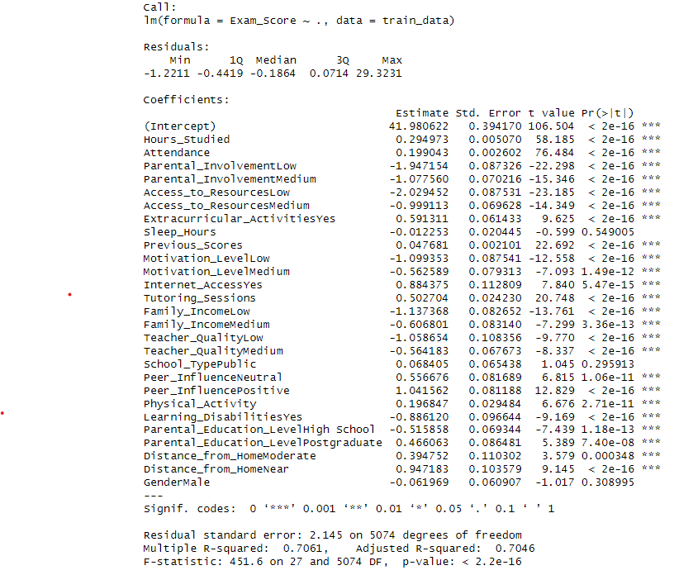
Initial Model Selection
Multiple Linear Regression
Dependent Variable = Exam Score (continuous)
Aims:
1
Understand the relationships between factors and exam performance.
2
Examine the impact of each factor while controlling for others.
3
Provide interpretable coefficients showing how each variable affects exam score

Slide 12
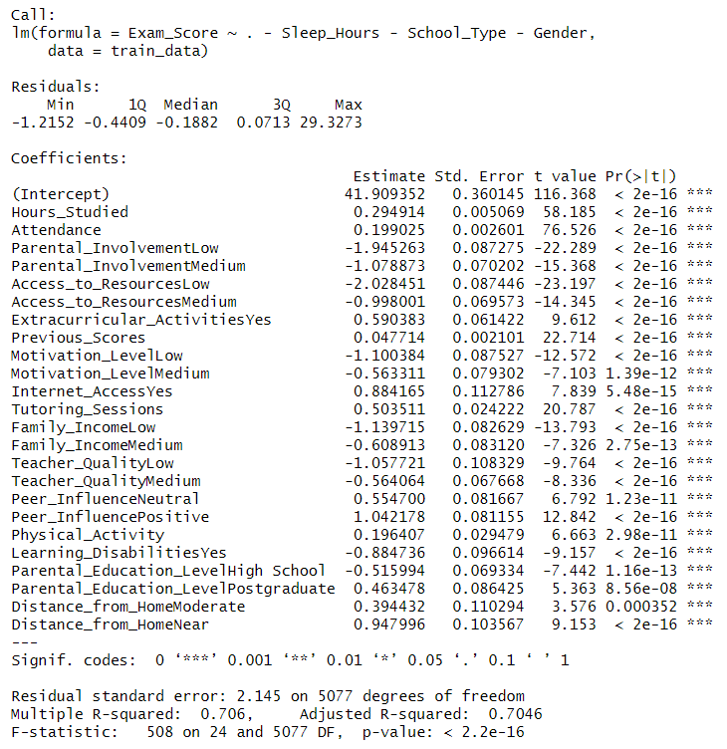
Creating a Reduce Model
The reduced model was created by selecting only predictors with a p-value < 0.05 from the full model, ensuring that only statistically significant variables were included
Found Sleep Hours, School Type, and Gender to be insignificant to the response based on the p-values.
The p- value for the model < 0.05 with all variables being significant, indicating that removing the variables did not reduce the predictive power of the model.

Slide 13
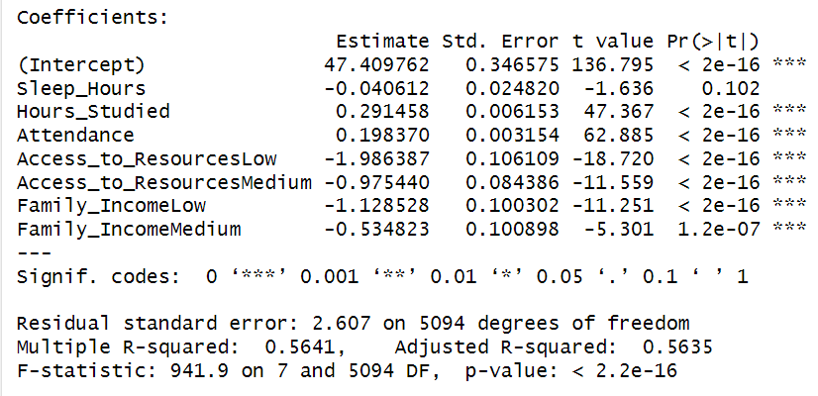
Creating a Custom Model
Subset of predictors selected:
Sleep Hours: Strongly linked to cognitive functioning and academic outcomes (Curcio et al., 2006; Hershner et al., 2020).
Hours Studied: Correlates with commitment and academic success (Zubair et al., 2024).
Access to Resources: Research underscores socio-economic status as a substantial factors influencing academic performance. (Hijazi and Naqvi, 2006).
Family Income: Positively associated with improved academic outcomes. (Naqvi, 2006)
Attendance: Strong predictor of academic excellence (Crede, 2009).

Slide 14
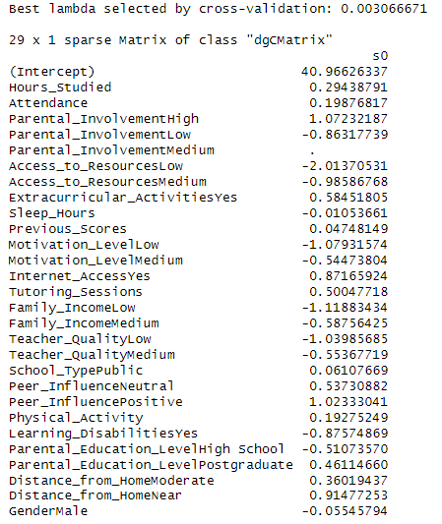
Lasso Regression Model
Regularization via L1 penalty to prevent overfitting – important because most variables in the data set are highly correlated
Feature selection through coefficient shrinkage – Important to exclude irrelevant variables because our dataset is highly dimensional
Applied 10-fold cross-validation to find the optimal penalty parameter.

Slide 15
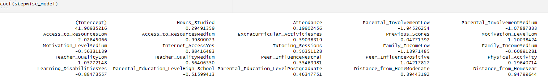
Stepwise Selection
Based on Akaike Information Criterion (AIC).
Iteratively adds and removes variables from a model to find the best performing subset of variables.
Balances model fit with simplicity.
Identifies the most significant predictors.
Ends up being the same as the reduced model (removed Sleep Hours, Gender, School Type variables)

Slide 16
04
Results

Slide 17
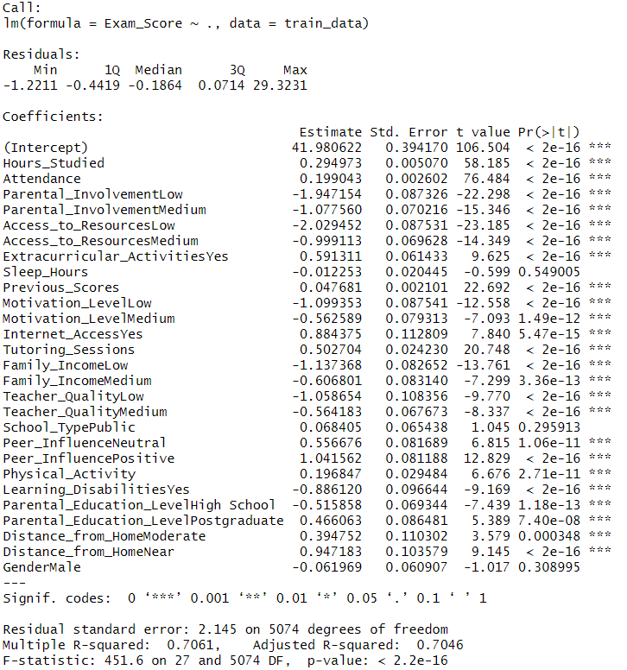
Analysis of Results
Multiple Linear Regression
Dependent Variable
Exam Score
Independent Variable
All IP variables
Insignificant Variables
Sleep Hours
School Type
Gender
Model is significant High F-statistic of 451.6 and the extremely low P-Value (2.2e-16)
Adjusted R-squared
Suggests that approximately 70.46% of the variance in Exam Scores is explained

Slide 18
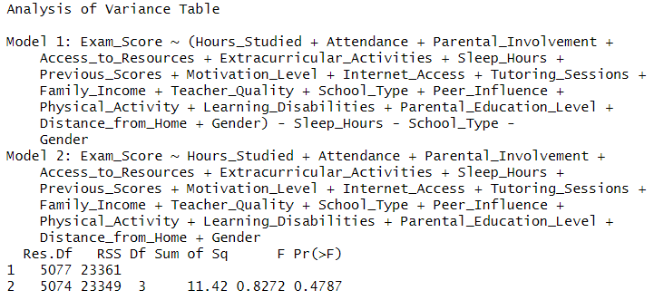
Analysis of Results
Reduced Linear Regression
Dependent Variable
Exam Score
Independent Variable
All IP variables – Sleep Hours, School Type, Gender
The Residual Sum of Squares for the two models differed only slightly (11.42) suggesting that removing these variables does not affect the amount of unexplained variability in Exam Score.
P-value from the F-test (0.4787) is greater than the significance level of 0.05, indicating that reduction in model complexity does not lead to a statistically significant loss of explanatory power.

Slide 19
Analysis of Results
Lasso Regression
Incorporates regularization to enhance interpretability and predictive accuracy.
Variable | Coeff. | Interpretation
Gender Male | -0.055 | Males score slightly (~0.06 points) lower than females, though the impact is minimal.
Sleep Hours | -0.011 | Negligible impact on scores, suggesting sleep hours in this dataset do not significantly influence academic performance.
School Type Public | 0.061 | Minimal positive impact, indicating school type (public/private) is not a strong predictor of exam scores.
Parental Involvement Medium | 0 | Eliminated by LASSO, meaning medium parental involvement does not significantly differ from the baseline in predicting scores.
High dimensionality of our dataset, feature selection was crucial to identify and exclude irrelevant variables (those with coefficients equal to zero). This process simplifies the model and helps prevent overfitting.
The data was divided into 10 folds for cross-validation, the best lambda value that minimized the cross-validation error was found to be 0.003066671.

Slide 20
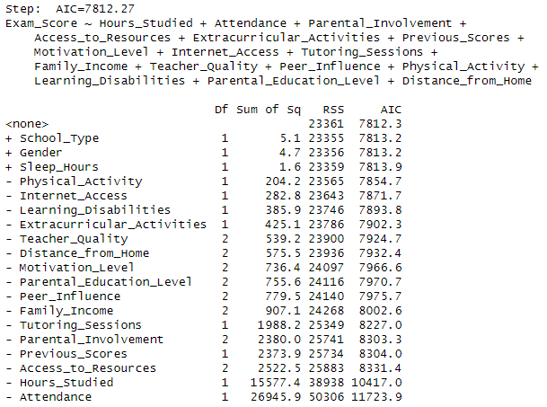
Analysis of Results
Stepwise Selection Model
Used AIC for forward selection and backward elimination.
The final model after the removal of sleep hours, gender, and school type strikes an optimal balance between model fit and predictive performance, as evidenced by the AIC reduction and minimal change in RSS.
AIC in first step: 7815.77
AIC in last step: 7812.27

Slide 21
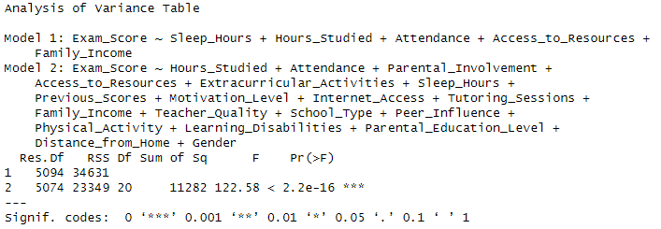
Analysis of Results
Handpicked Model
F-test with a p-value of less than 0.05 (< 2.2e-16) showed that the additional variables in the full model are significant and capture a large proportion of variability in the dependent variable, so it may be necessary to include some other predictors.

Slide 22

Analysis of Results
Comparing Models using AIC
A lower AIC value suggests a better model fit when comparing models that have been fit on the same dataset.
Reduced, Stepwise, and Lasso Models have low AIC values of 7812.267 and 7814.304
Custom model has the highest AIC value, indicating underfitting due to its lack of complexity of the model which compromised the model’s predictive power.

Slide 23
Analysis of Results
Comparing Models using R Squared
Adjusted R squared shows the amount of variance in the dependent variable that can be explained by the independent variables.
Stepwise and reduced models have the highest R^2 suggesting that the models have identified the relevant predictors.
Lasso has a slightly lower R^2 indicating it doesn’t reduce explanatory power
Custom model has the lowest R^2 indicating over simplicity or non-linear relationships

Slide 24
Analysis of Results
Lasso model emerged as the top choice for predicting the effect of various factors on student performance
Had an AIC slightly higher than reduced and stepwise model – negligible difference can be ignored since Lasso regularization improves the interpretability and prevents overfitting
Stepwise and reduced models depend on variable selection methods like the stepwise regression or the backward elimination, they might not effectively handle data that is highly dimensional and multicollinear.
There were some outliers that could introduce bias but for the most part the linearity, independence, constant variances and normality assumptions hold.
RMSE on test data = 1.74 – indicates small errors and better performance of the model

Slide 25
05
Limitations and Future Research

Slide 26
Limitations
01
02
Artificially generated data
Missing Data and Outliers
The data set has some rows with missing data that were removed, and outliers present in the data. These outliers and missing values may have created bias in model’s predictions.
The data set was synthetically generated making real world application difficult

Slide 27
Future Research
1
Expand Variables
To create a better predictability for our model we suggest expanding the variables. Many different variables impact grades, much more than explored in this data set.
Real world data collection
2
Comparing our model to real world data would help determine how applicable our model is to real situations

Slide 28
Future Research
3
Use advanced techniques for outlier handling
Transformations, imputations
4
Try Classification Model instead of Prediction Model
May be more practical and offer better insights

Slide 29
Thank You

